Slide 1
Analyzing and Predicting the Growth of Tesla’s Supercharger Network in North America
Complex Network’s Final Project
Cole MacLean
June 22, 2016

Slide 2
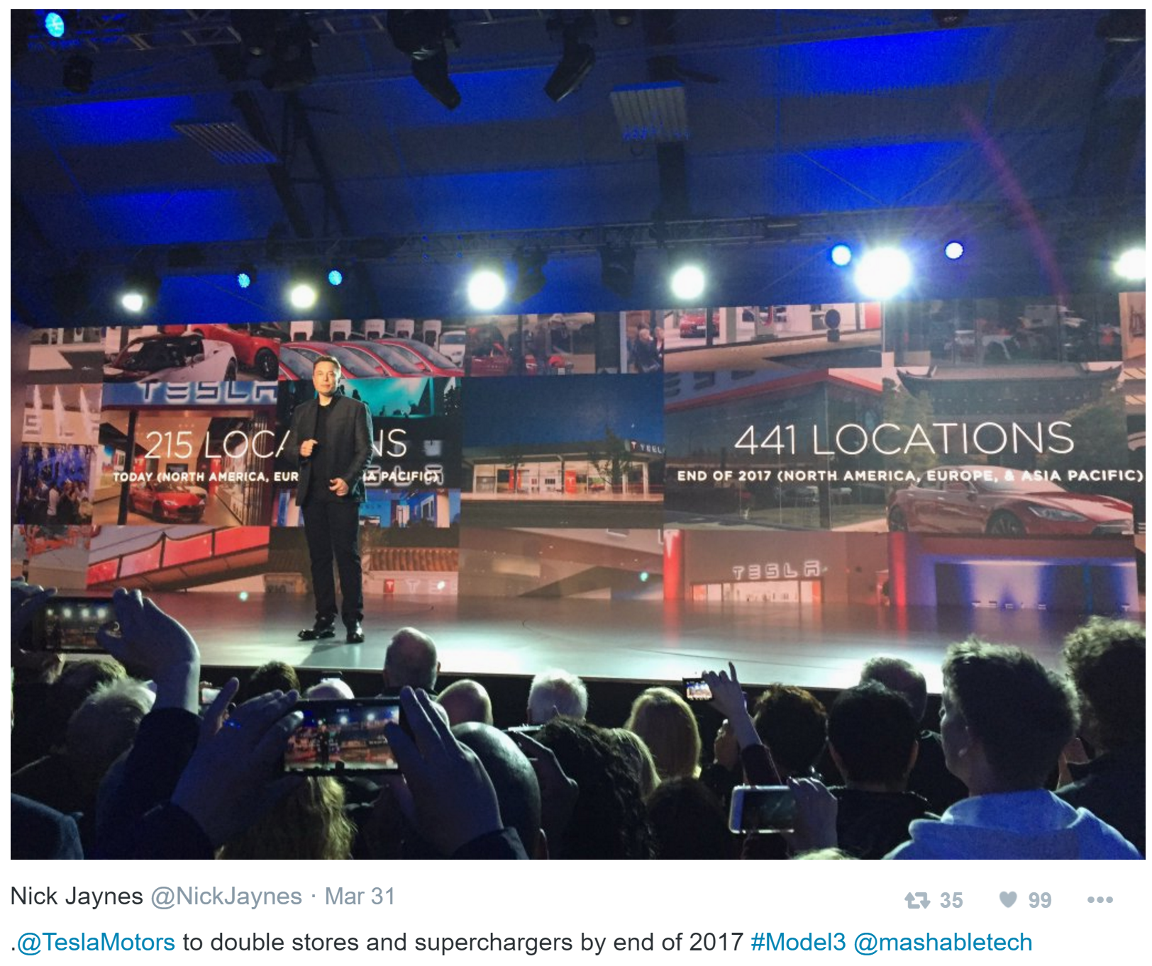
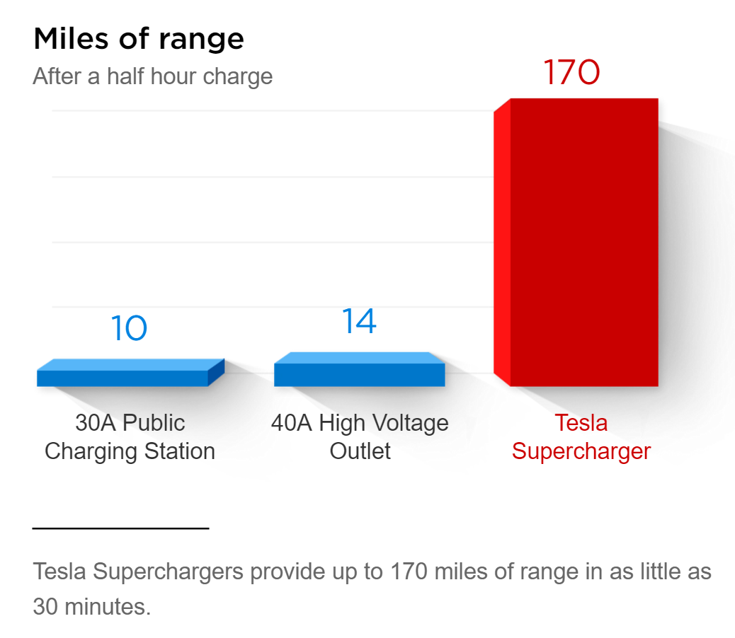

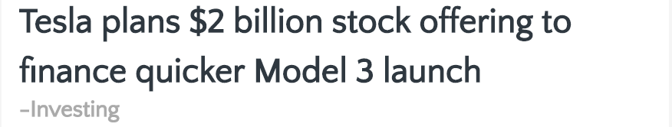


Slide 3
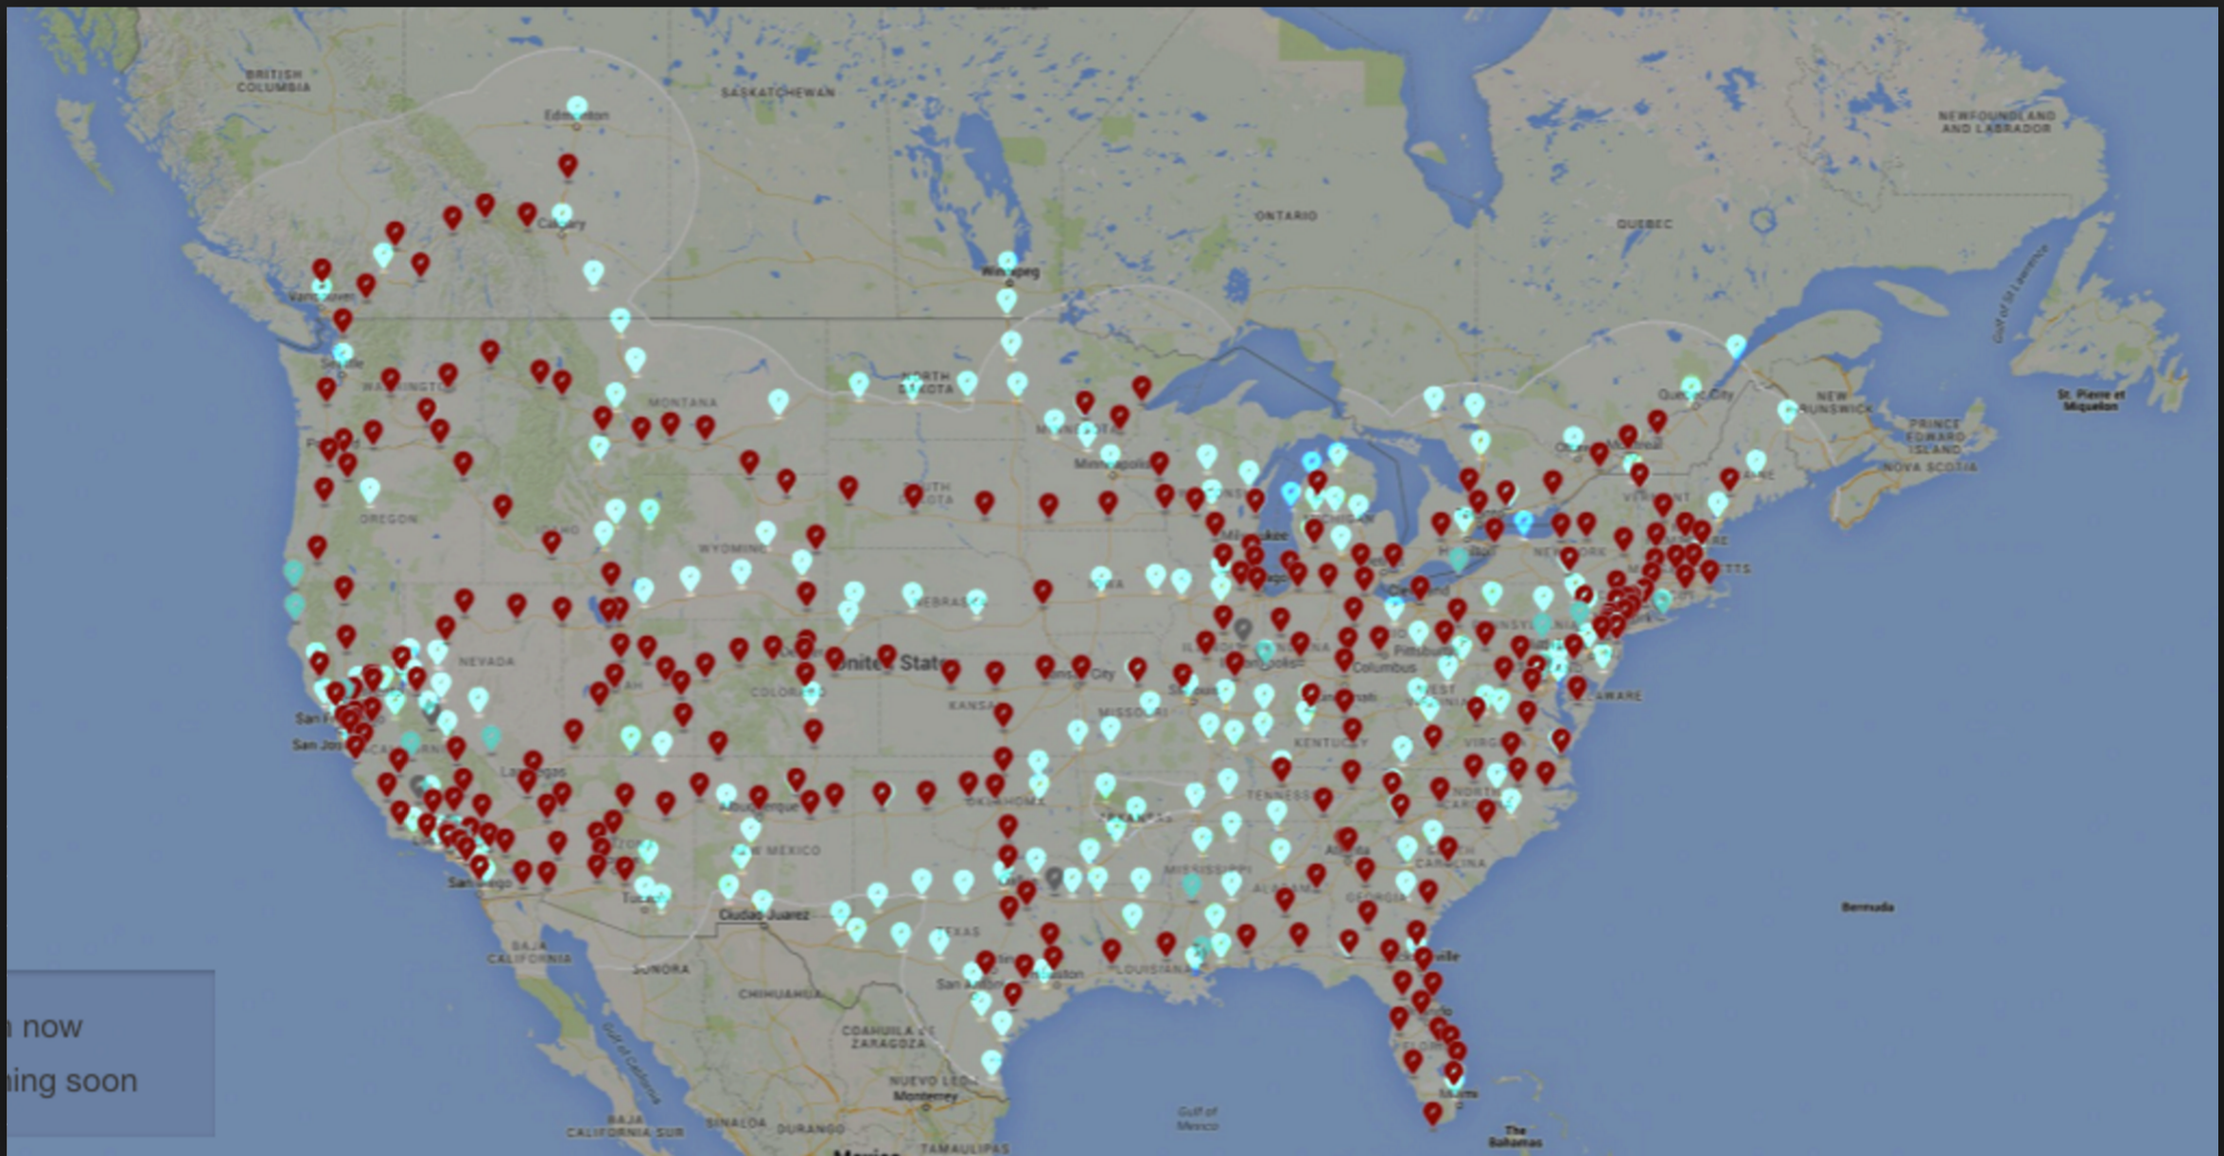


Current Supercharger
2016 Supercharger Plan

